Slide 1






Notes:
THE ORCHESTRA MOVES

Slide 2
Table of Contents:
Concert Overview
Beethoven’s 5th
Orchestra Families
Come to Play
Mhande
Danzón
Blue Danube
Ode to Joy
Toredor
Oye
Resources for Teachers
The Orchestra Sings Website Link
The Orchestra Moves Website Link
Notes:
BROWN

Slide 3
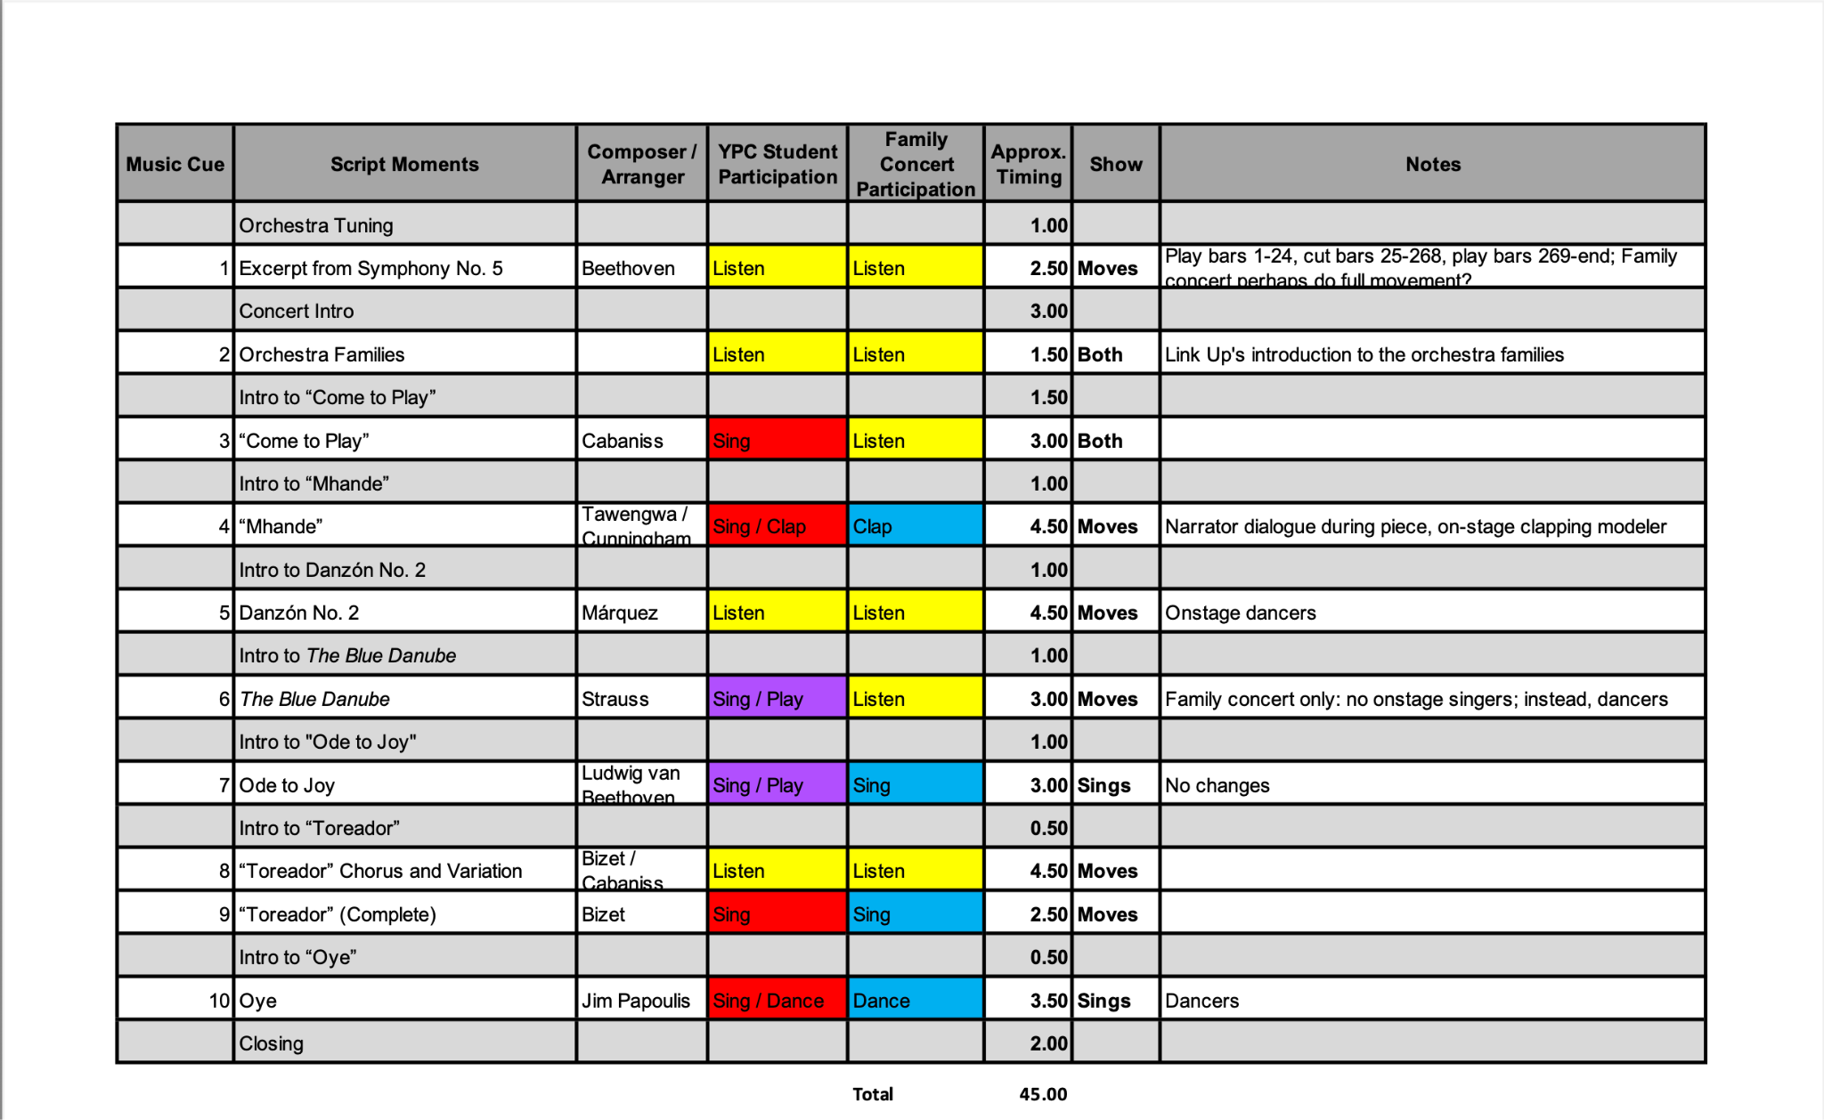
Concert Overview
Click for Table of Contents
Notes:
BROWN

Slide 4

Click for Table of Contents

Slide 5


Animated Score
Link to Carnegie Hall website: https://www.carnegiehall.org/Education/Programs/Link-Up/National-Program/The-Orchestra-Moves/Allegro-con-brio#video
Click for Table of Contents

Slide 6
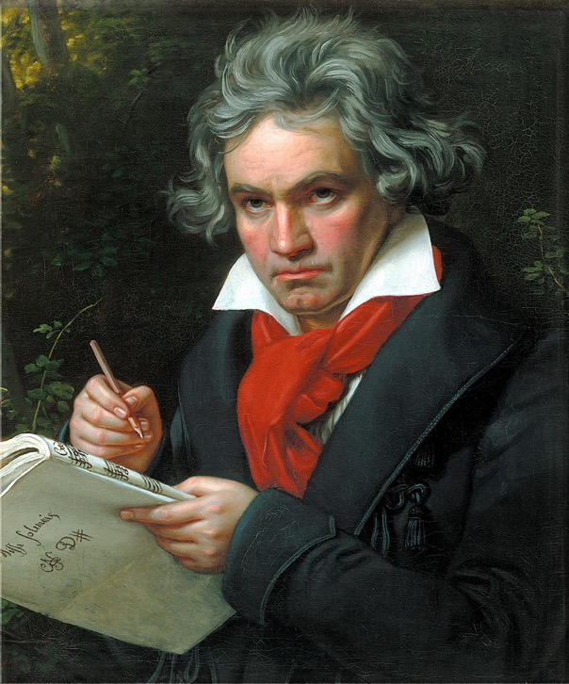
About the Composer
Ludwig van Beethoven was born in Bonn, Germany. His father, who was a singer, was his first teacher. After a while, even though he was still only a boy, Ludwig became a traveling performer, and soon, he was supporting his family.
In his early twenties, Beethoven moved to Vienna, where he spent the rest of his life. Beethoven was one of the first composers to make a living without being employed by the church or a member of the nobility. At first, he was known as a brilliant pianist. But when he was around 30 years old, Beethoven started going deaf. Even though he could no longer hear well enough to play the piano, Beethoven composed some of his best music after he was deaf!
Beethoven is considered one of the greatest musical geniuses who ever lived. He may be most famous for his nine symphonies, but he also wrote many other kinds of music: chamber and choral music, piano music and string quartets, and an opera.
Click for Table of Contents

Slide 7


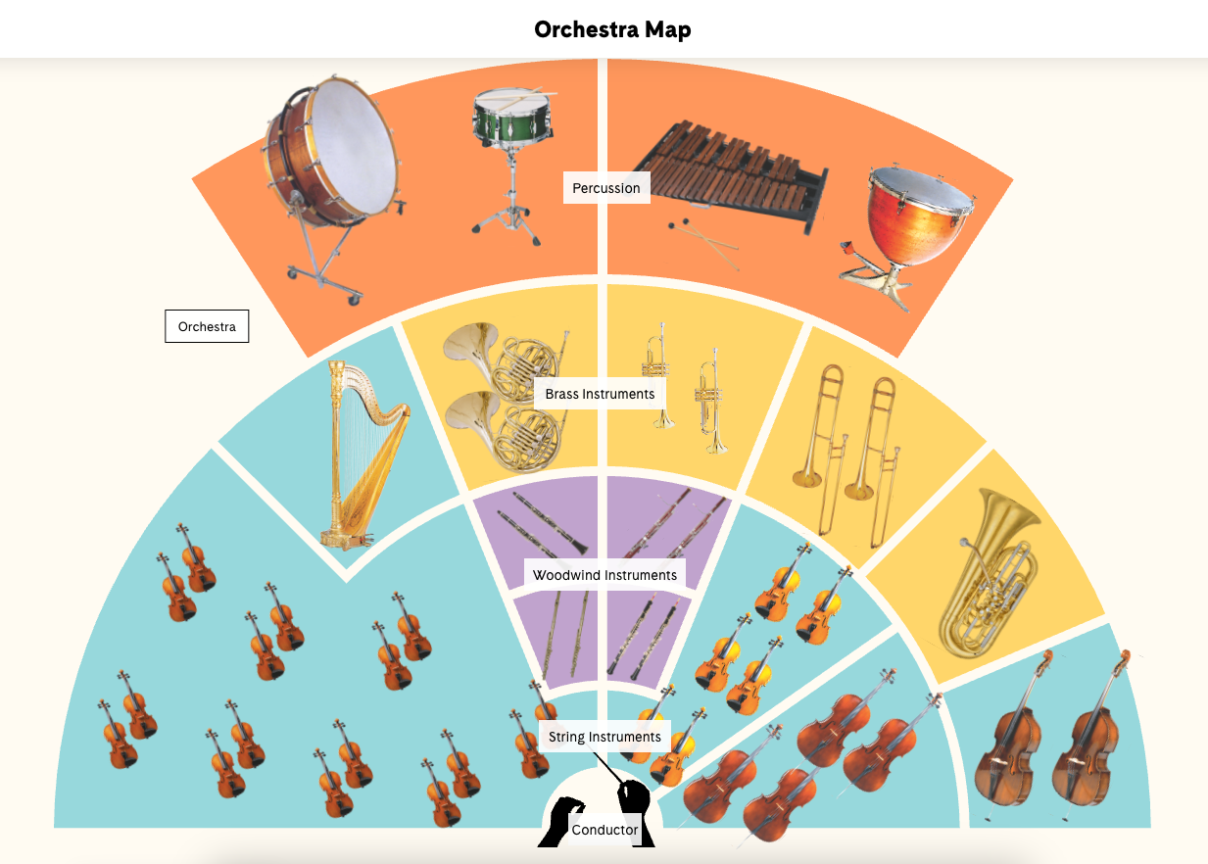
Click for Table of Contents
Notes:
ORCHESTRA MAP

Slide 8
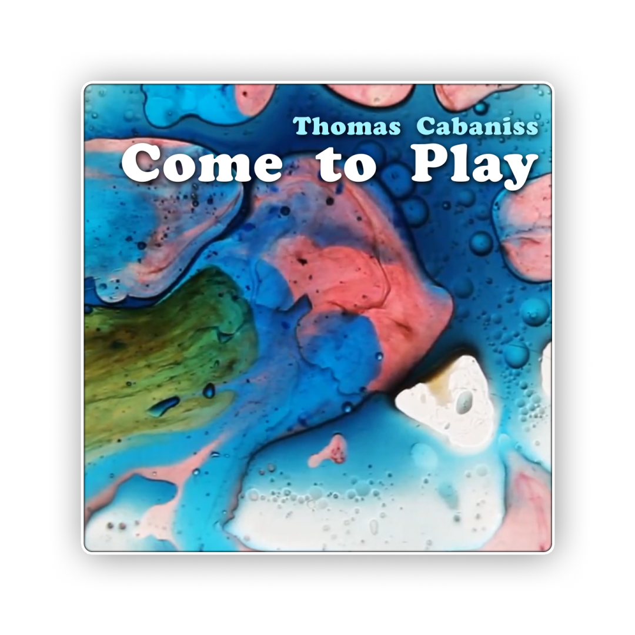
Click for Table of Contents
Notes:
COME TO PLAY TITLE

Slide 9
The song has three parts, but only the Lyrics of Part 1 and Part 2 are included.
Matter of personal opinion (Kaylin’s), it is easier for the student to pick-up one of these parts.
Teach one of the parts to your students! If you are ambitious, teach both! :)
Carnegie Hall Resources:
https://www.carnegiehall.org/Education/Programs/Link-Up/National-Program/The-Orchestra-Moves/Come-to-Play
Click for Table of Contents
Notes:
BROWN

Slide 10

Winds____ blow________
Trumpets sounding______
Strings____ sing________
Drummers p p p p p p pounding
Drummers p p p p p p pounding
Click for Table of Contents
Notes:
CTP MUSIC 1

Slide 11
Come to play,
Join sound with sound____
Come to sing
We’ll shake the ground with
Song________
Click for Table of Contents
Notes:
CTP MUSIC 2

Slide 12
Come to play,
Join sound with sound____
Come to sing
We’ll shake the ground with
Song______, with song________
Click for Table of Contents
Notes:
CTP MUSIC 3

Slide 13
Leader: What do you do with time?
Make it groove
Make it move
Make it rhyme____
Click for Table of Contents
Notes:
CTP MUSIC 4

Slide 14
Leader: What do you do with song?
Make it sing
Make it ring
Make it strong____
Click for Table of Contents
Notes:
CTP MUSIC 5

Slide 15
Make it long________________
Click for Table of Contents
Notes:
CTP MUSIC 6

Slide 16
Leader: What do you do with sound?
Make it cry
Make it fly
Make it gleam____
Click for Table of Contents
Notes:
CTP MUSIC 7

Slide 17
Make it your dream________
Click for Table of Contents
Notes:
CTP MUSIC 8

Slide 18
(Orchestra plays!)
Click for Table of Contents
Notes:
CTP MUSIC 9

Slide 19
Winds____ blow____
Trumpets sounding
Strings____ sing____
Drummers p p p p p p pounding
Drummers p p p p p p pounding
Click for Table of Contents
Notes:
CTP MUSIC 10

Slide 20
Part 1:
Part 2:
2x
2x
Winds____ blow____
Trumpets sounding
Strings____ sing____
Drummers p p p p p p pounding
Drummers p p p p p p pounding
Come to play,
Join sound with sound____
Come to sing
We’ll shake the ground with
Song________
Pick the part you want to sing!
Click for Table of Contents
Notes:
CTP MUSIC 11

Slide 21
Part 1:
Part 2:
shake the ground
with song________!
with song______
with song________!
Click for Table of Contents
Notes:
CTP MUSIC 12

Slide 22
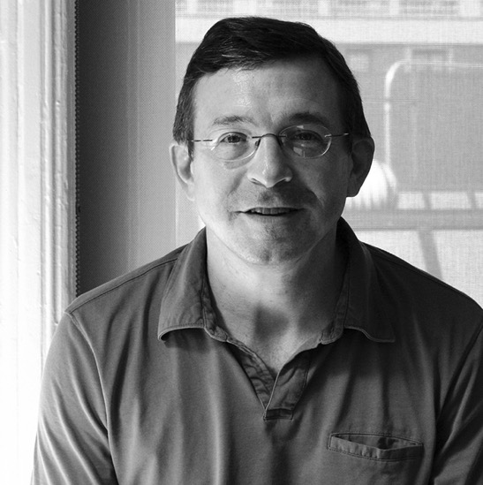
About the Composer
Thomas Cabaniss: Thomas Cabaniss (b. 1962) is a composer and educator born in Charleston, South Carolina. Residing in New York City, Cabaniss teaches at The Juilliard School and leads arts education programs throughout the city. His music ranges from chamber music to operas and film scores. He is a creative adviser for Carnegie Hall’s Link Up program, and helped launch Carnegie Hall’s Lullaby Project, which helps pregnant women, new mothers, and their families write songs for their children. Cabaniss uses his music to encourage collaboration and help institutions support partnerships between artists and communities.
Click for Table of Contents
Notes:
BROWN

Slide 23


Click for Table of Contents
Notes:
MHANDE TITLE

Slide 24

What does “Mhande” mean?
Mhande is a traditional performance that involves music and dance. It began with the Shona people of south Africa. Many Shona people live in Zimbabwe.
Click for Table of Contents
Notes:
COME TO PLAY TITLE

Slide 25

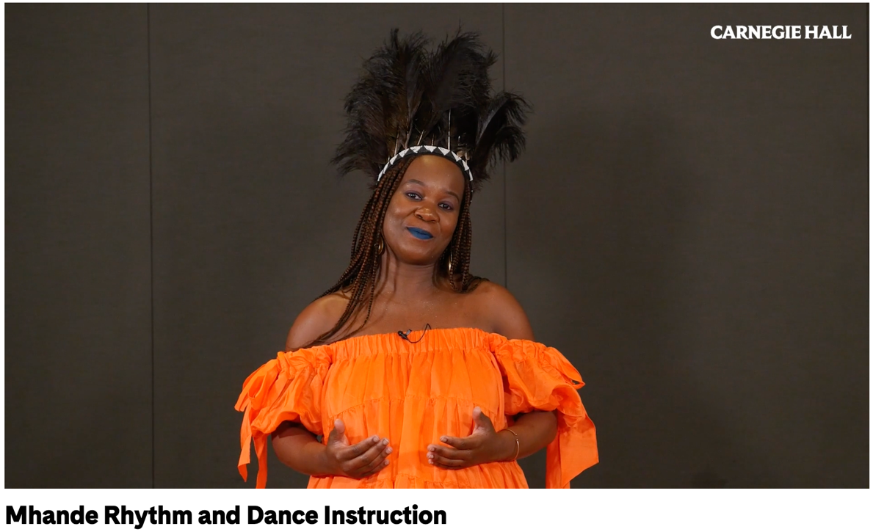
Link to Mhande Rhythm and Dance Video:
It will look like this. This video will last around 10 minutes.
https://www.carnegiehall.org/Education/Programs/Link-Up/National-Program/The-Orchestra-Moves/Mhande#video
It will look like this. This video will last around 10 minutes.
Click for Table of Contents
Notes:
COME TO PLAY TITLE

Slide 26
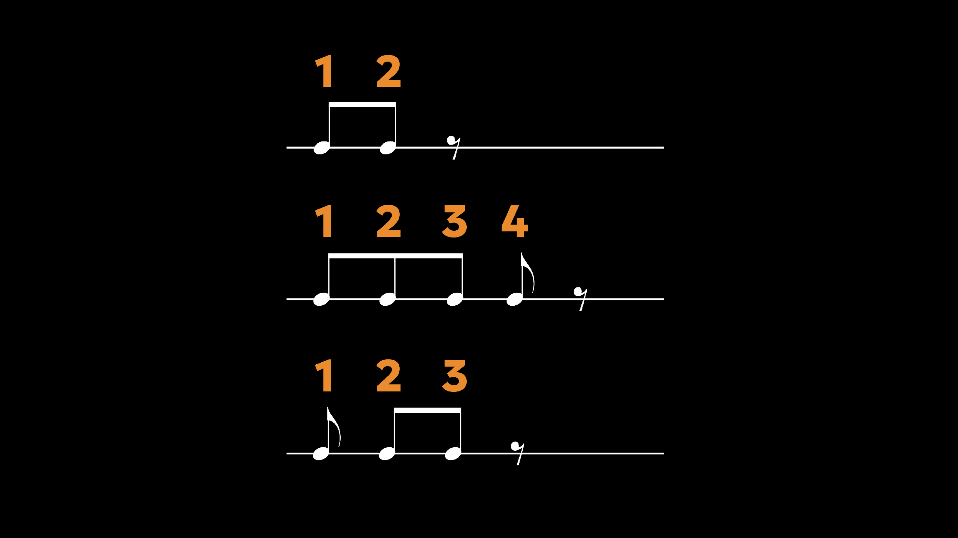
Click for Table of Contents
Notes:
MHANDE RHYTHM

Slide 27
Get ready to sing!
Click for Table of Contents
Notes:
BLUE

Slide 28

Sing the response 12 times!
(response)
Tzee – no - roo - ma Nyoo - chee
Click for Table of Contents
Notes:
MHANDE LYRICS

Slide 29
Get ready to clap!
Click for Table of Contents
Notes:
BLUE

Slide 30
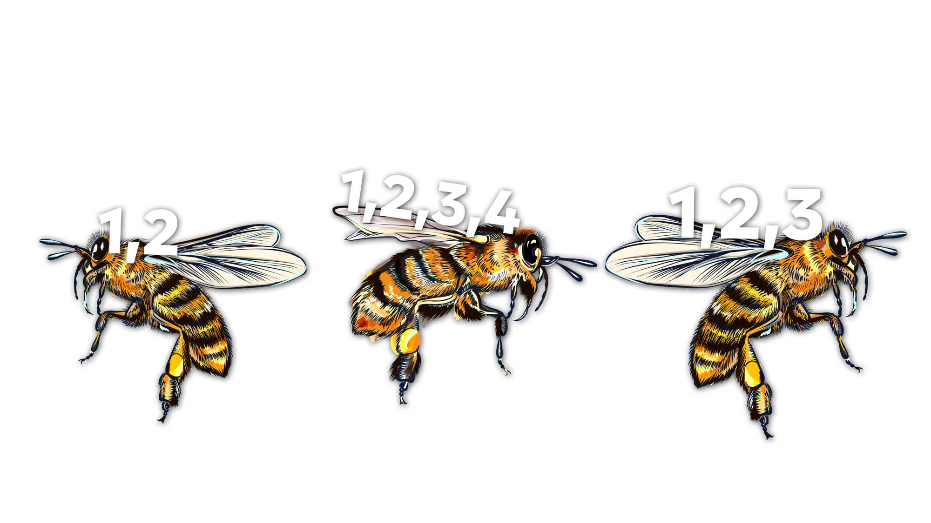

Clap this rhythm 6 times!
Click for Table of Contents
Notes:
MHANDE RHYTHM

Slide 31
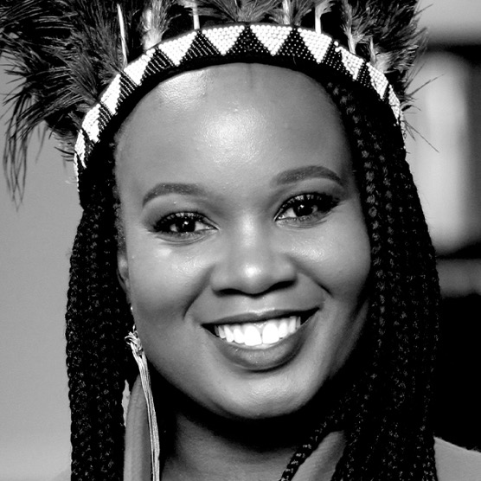
About the Composer
Tanyaradzwa A. Tawengwa: Tanyaradzwa A. Tawengwa (b. 1991) is a Zimbabwean gwenyambira, composer, scholar, and singer whose work builds a bridge between Madzimbabwe and Western classical music traditions. Her music is grounded in the ancestral Chivanhu canon taught to her by the generations of svikiro (spirit mediums) and n’anga (healers) in her bloodline. Tawengwa began singing and playing the piano and cello at a young age and was called to carry on the sacred tradition of mbira music when she was 16. As a child, she would dream of songs and music being sung to her by her ancestors—dreams that continue today. Tawengwa is the founder of Zimbabwe KIDS Summer Camp, Mushandirapamwe Arts Trust, and the Mushandirapamwe Singers. Her work and music have been performed at Carnegie Hall, Boston Lyric Opera, the Royal Opera of Versailles, Yale Repertory Theatre, Soho Repertory Theatre, National Sawdust, The Playroom Theater, The Public Theater, The Glimmerglass Festival, TED, and TEDWomen.
Click for Table of Contents
Notes:
COME TO PLAY TITLE

Slide 32


Click for Table of Contents
Notes:
DANZON TITLE

Slide 33
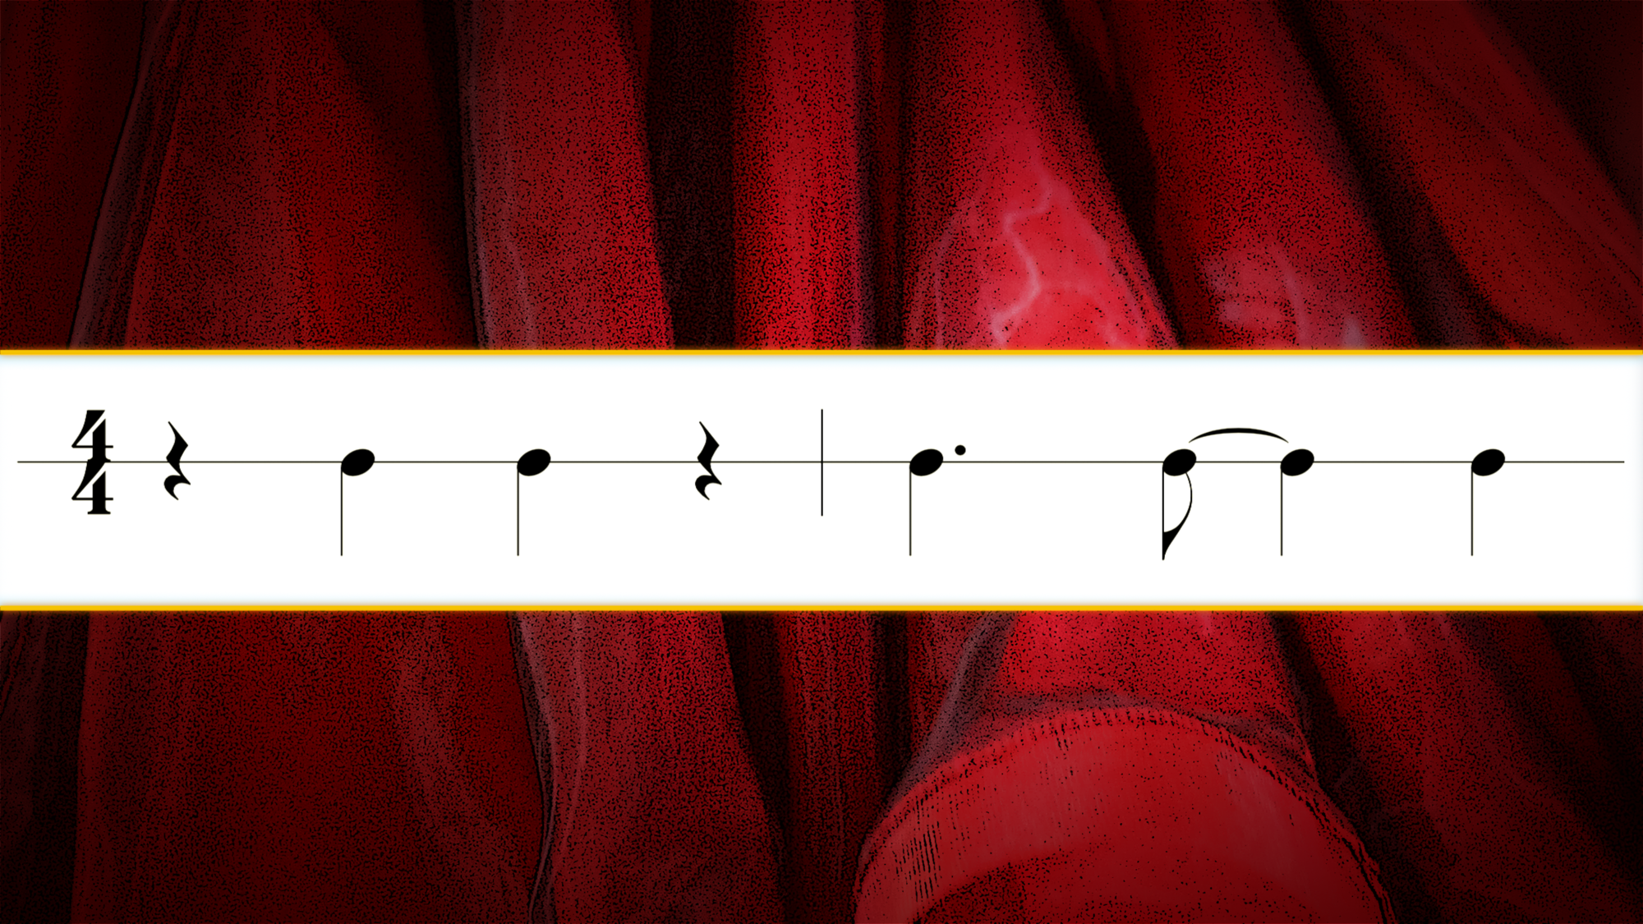
You will hear this rhythm throughout the piece!
Listen carefully as the orchestra plays!
Can you hear it?
Click for Table of Contents
Notes:
CLAVE RHYTHM

Slide 34
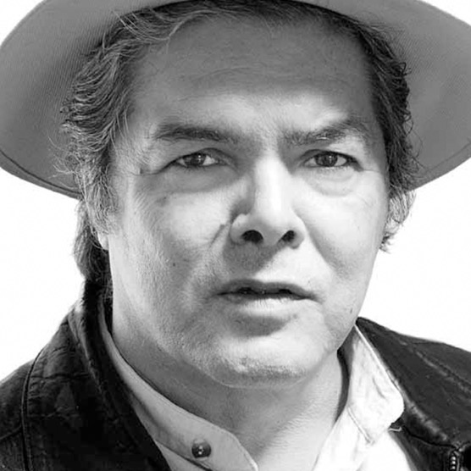
About the Composer
Arturo Marquez: Arturo Márquez (b. 1950) is one of the most prominent Mexican classical composers. Born in Alamos, Mexico, he was introduced to music by his father, a mariachi musician, and his grandfather, a folk musician. Márquez’s family moved to Los Angeles when he was 11, and he remained committed to music, composing, and playing the violin in school. When he was 17 years old, Márquez went to the Mexican Music Conservatory to study composition. He later studied music in Paris before returning to California. His earlier works were experimental in style. When he returned to Mexico, Márquez wanted to reach a broader audience. He began to frequent Mexico City’s dance halls, where he discovered the danzón. His most famous works are eight danzónes that incorporate this Mexican style into classical forms. Márquez currently lives in Mexico City, where he teaches and continues to compose.
Notes:
COME TO PLAY TITLE

Slide 35


Teacher Note:
Students will SING the A sections
Students will PLAY on the B section ONLY!
Click for Table of Contents
Notes:
BLUE DANUBE TITLE

Slide 36

REST WHILE THE ORCHESTRA PLAYS
Click for Table of Contents
Notes:
BLUE DANUBE MUSIC 1

Slide 37


A beautiful stream
so clear and blue
A beautiful dream
of me and you
Click for Table of Contents
Notes:
BLUE DANUBE MUSIC 1

Slide 38
The stars seem to float
above the sky
With us as we go
they fly, so high
Click for Table of Contents
Notes:
BLUE DANUBE MUSIC 1

Slide 39
We’re up in the air
up in the air
As high as we dare
high as we dare
Click for Table of Contents
Notes:
BLUE DANUBE MUSIC 1

Slide 40
We’ll never come down
we will stay
Until night becomes the day!
Click for Table of Contents
Notes:
BLUE DANUBE MUSIC 1

Slide 41
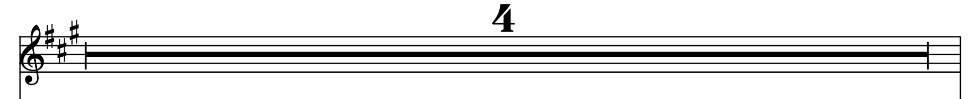
Get ready to play recorder!
Click for Table of Contents
Notes:
BLUE DANUBE MUSIC 13

Slide 42
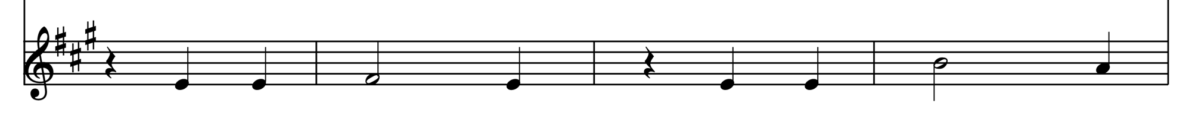
PLAY!
Click for Table of Contents
Notes:
BLUE DANUBE MUSIC 14

Slide 43
Click for Table of Contents
Click for Table of Contents
Notes:
BLUE DANUBE MUSIC 13

Slide 44
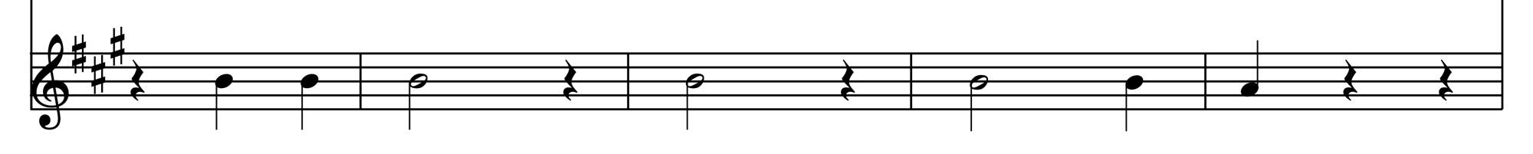
PLAY!
Click for Table of Contents
Notes:
BLUE DANUBE MUSIC 16

Slide 45
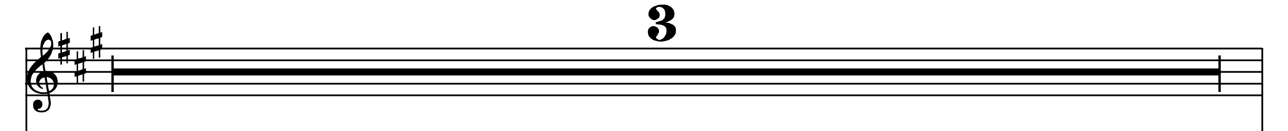
Click for Table of Contents
Notes:
BLUE DANUBE MUSIC 17

Slide 46
PLAY!
Click for Table of Contents
Notes:
BLUE DANUBE MUSIC 14

Slide 47
Click for Table of Contents
Notes:
BLUE DANUBE MUSIC 13

Slide 48
PLAY!
Get ready to sing!
Click for Table of Contents
Notes:
BLUE DANUBE MUSIC 16

Slide 49
A beautiful stream
so clear and blue
A beautiful dream
of me and you
Click for Table of Contents
Notes:
BLUE DANUBE MUSIC 1

Slide 50
The stars seem to float
above the sky
With us as we go
they fly, so high
Click for Table of Contents
Notes:
BLUE DANUBE MUSIC 1

Slide 51
We’re up in the air
up in the air
As high as we dare
high as we dare
Click for Table of Contents
Notes:
BLUE DANUBE MUSIC 1

Slide 52
We’ll never come down
we will stay
Until night becomes the day!
Ba-dum bum!
Click for Table of Contents
Notes:
BLUE DANUBE MUSIC 1

Slide 53
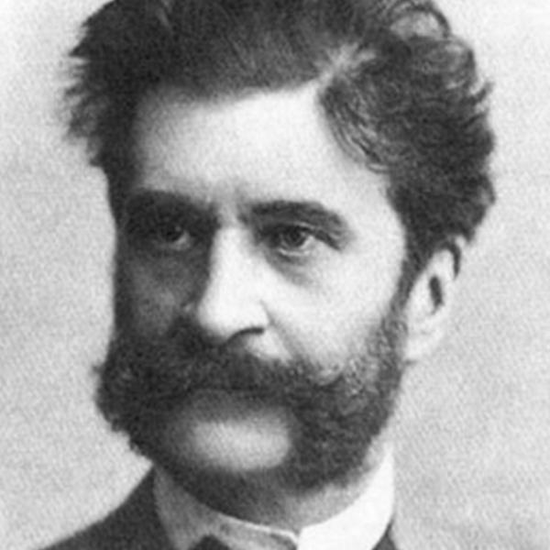
About the Composer
Johann Strauss: Johann Strauss II (1825–1899) was born in Vienna, where his father was a famous musician. Although his father urged him not to pursue music (he wanted him to become a banker), Strauss rebelled against the idea and studied violin in secret. At the age of 19, Strauss started his own orchestra and conducted his first public concert. He went on to become a productive composer and tour internationally with his orchestra. Known as the “Waltz King,” he wrote more than 500 waltzes, polkas, quadrilles, and other types of dance music, as well as many operettas.
Click for Table of Contents
Notes:
COME TO PLAY TITLE

Slide 54

Click for Table of Contents
Notes:
ODE TITLE

Slide 55


REST WHILE THE ORCHESTRA PLAYS
Click for Table of Contents
Notes:
ODE MUSIC 5

Slide 56
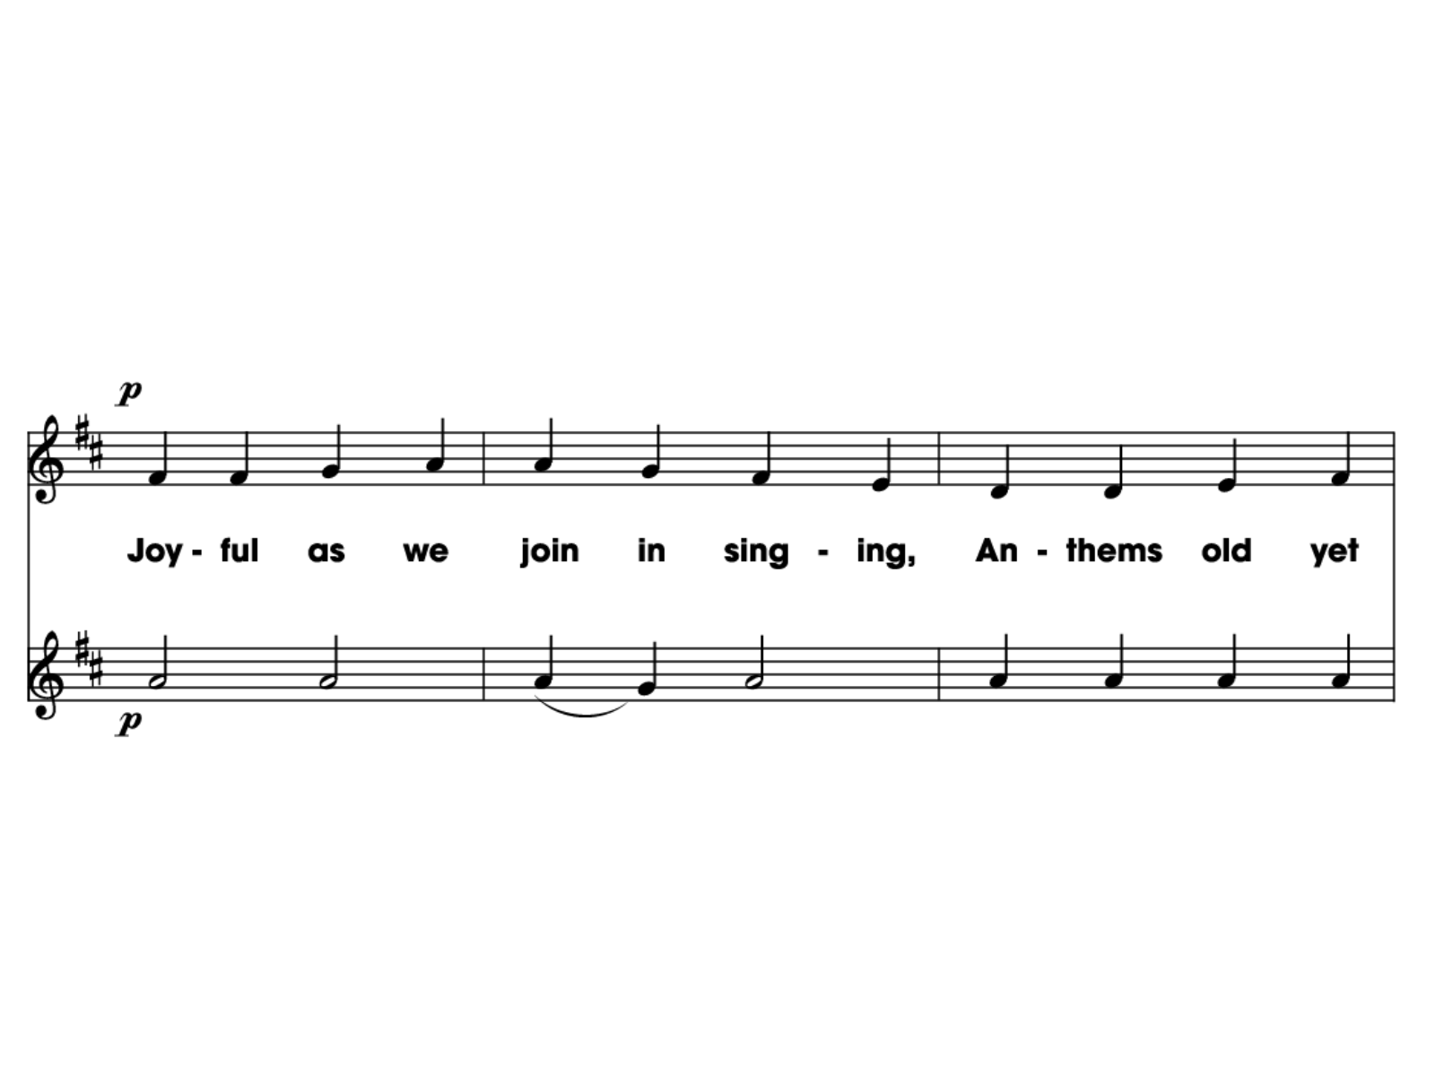
SING!
PLAY!
Click for Table of Contents
Notes:
ODE MUSIC 1

Slide 57
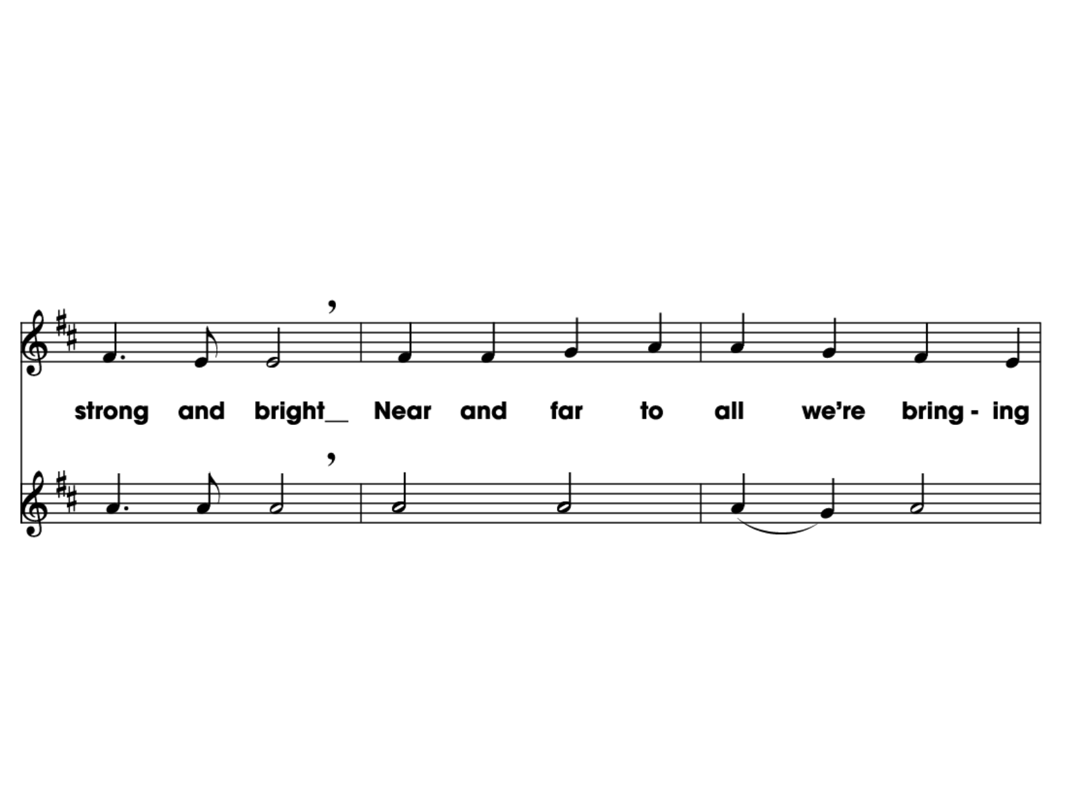
SING!
PLAY!
Click for Table of Contents
Notes:
ODE MUSIC 2

Slide 58
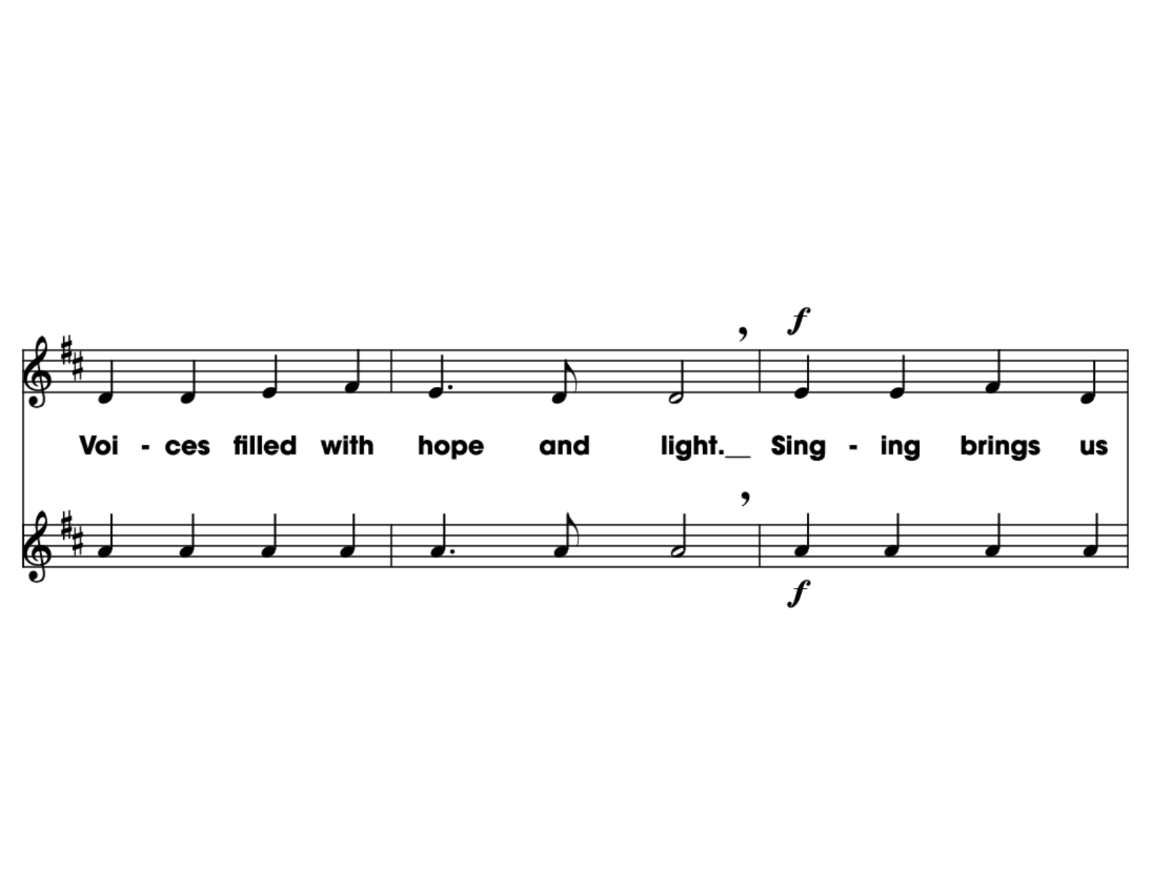
SING!
PLAY!
Click for Table of Contents
Notes:
ODE MUSIC 2

Slide 59
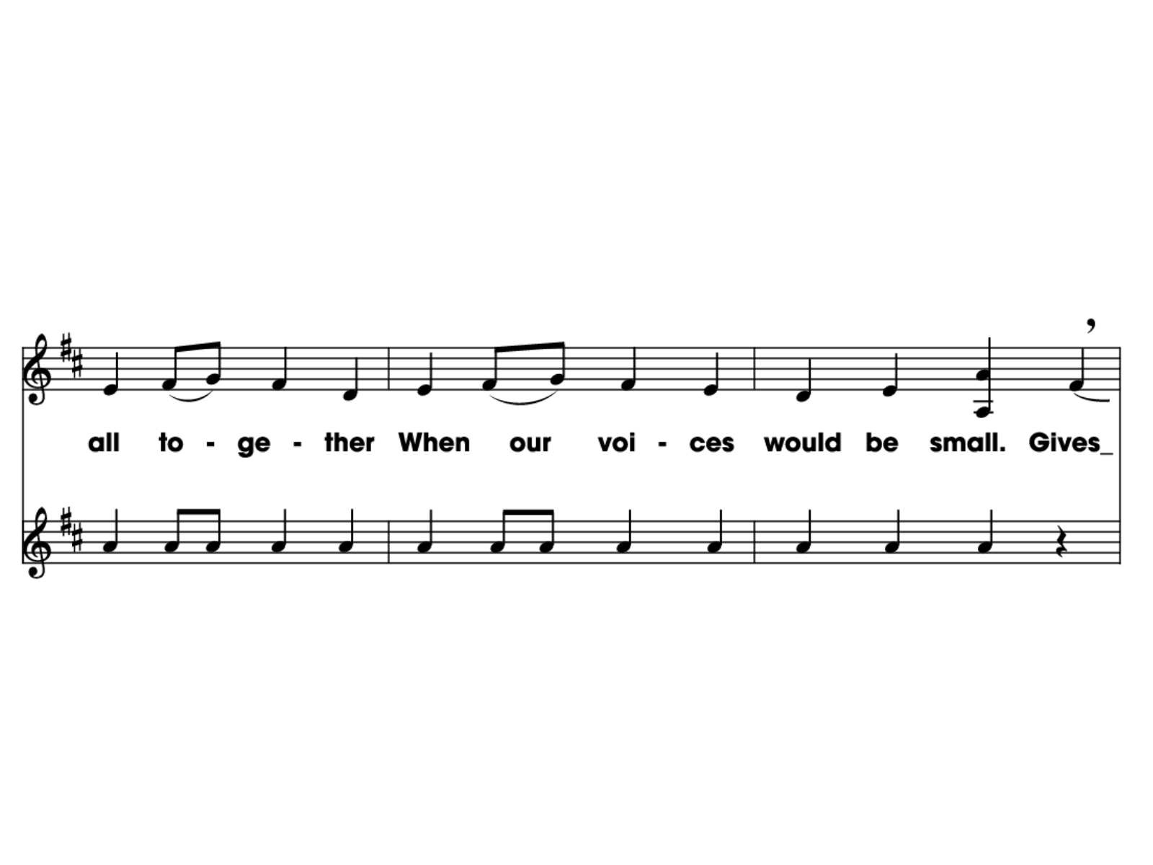
SING!
PLAY!
Click for Table of Contents
Notes:
ODE MUSIC 3

Slide 60
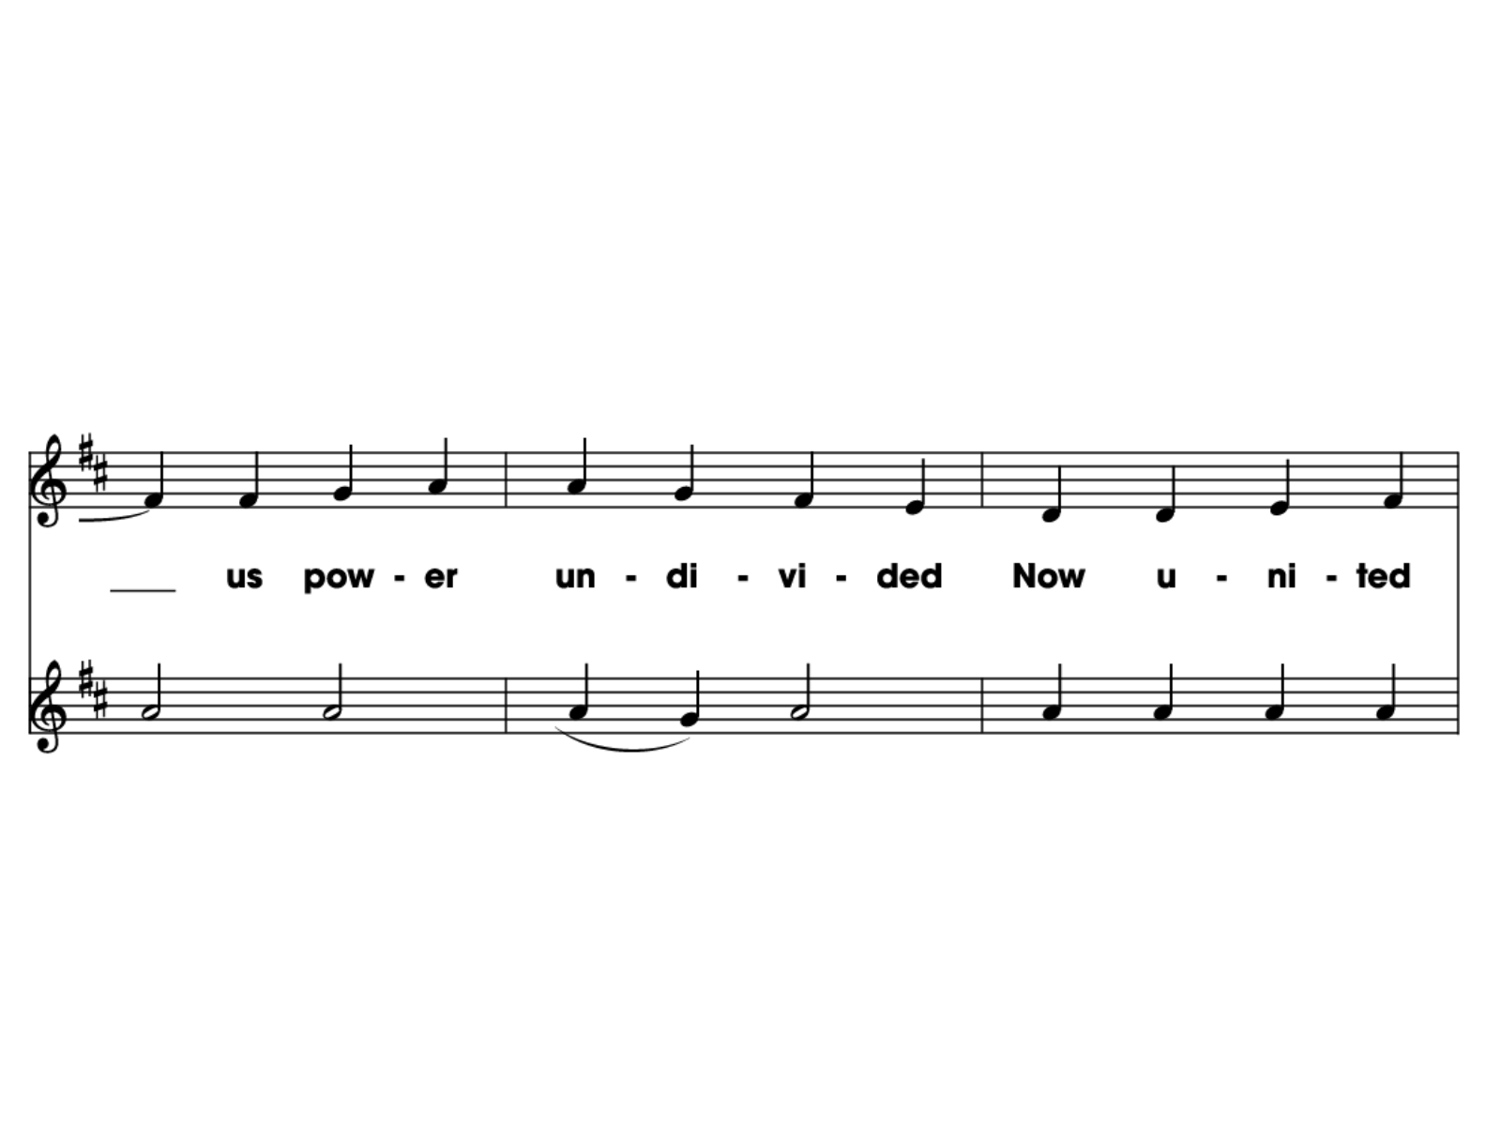
SING!
PLAY!
Click for Table of Contents
Notes:
ODE MUSIC 3

Slide 61
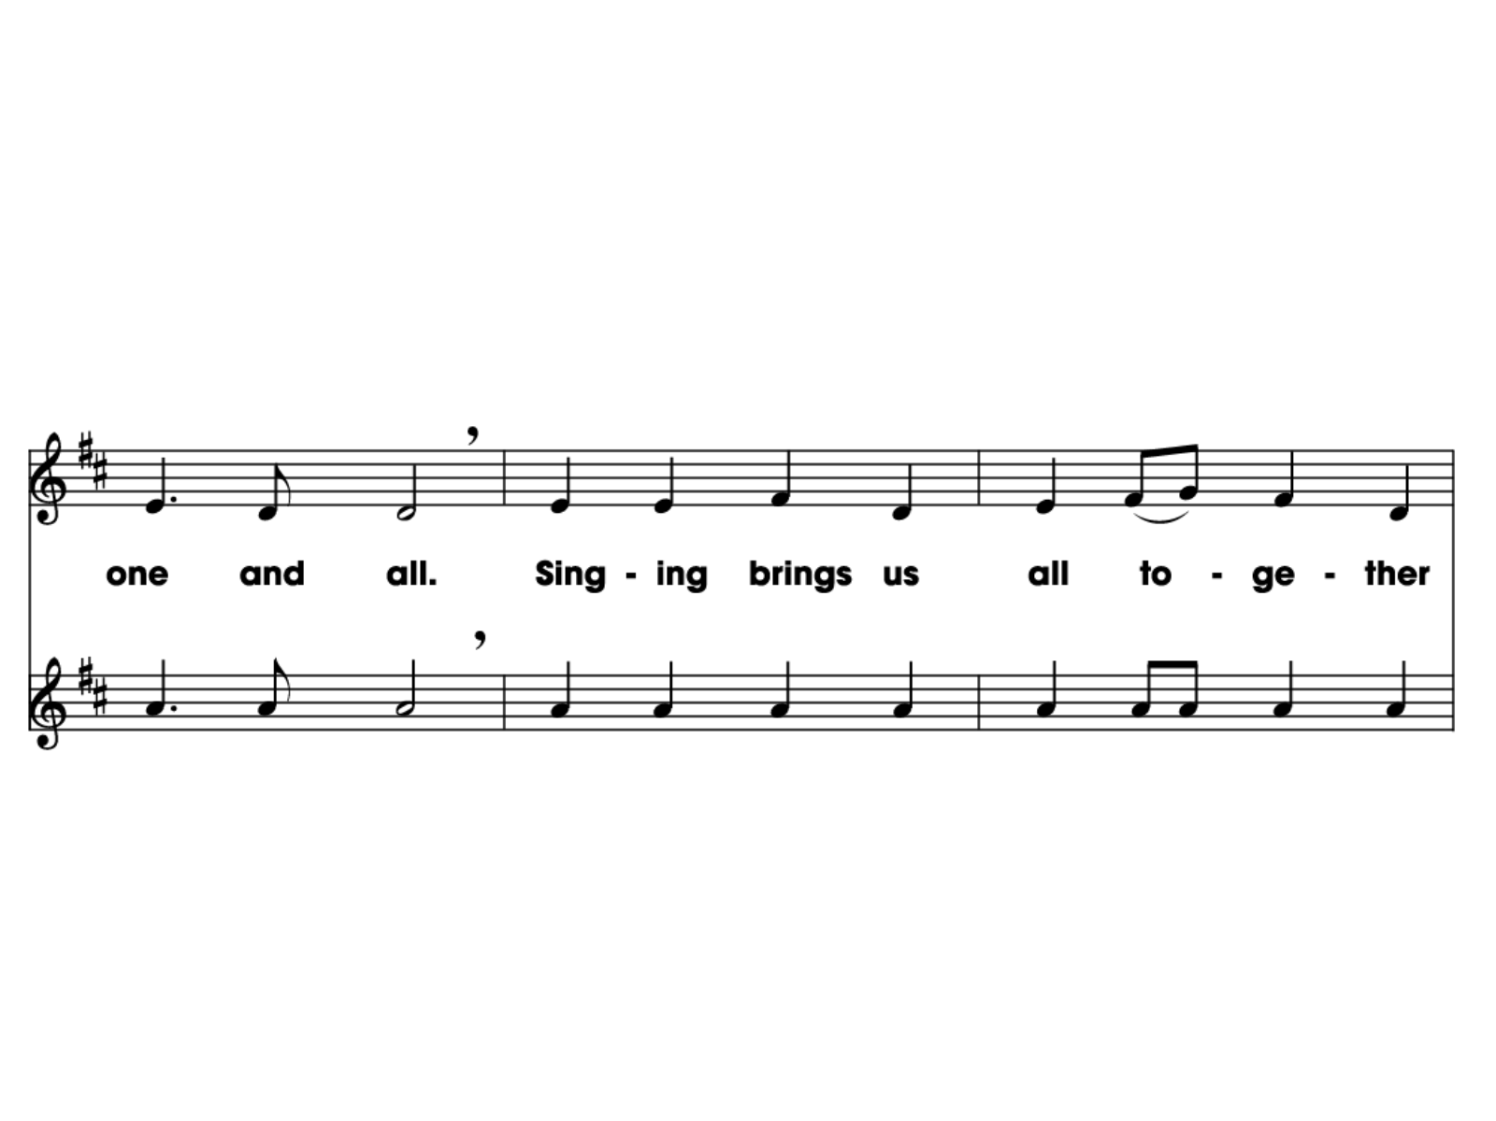
SING!
PLAY!
Click for Table of Contents
Notes:
ODE MUSIC 4

Slide 62
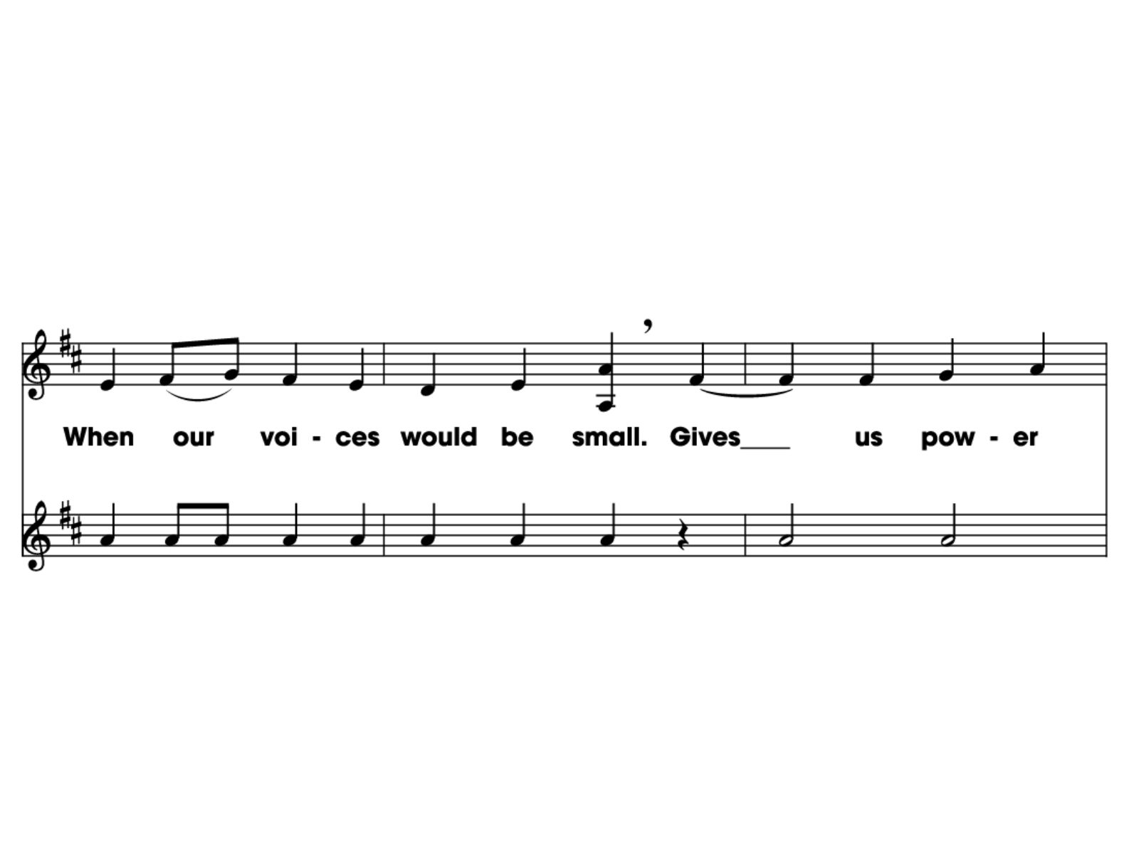
SING!
PLAY!
Click for Table of Contents
Notes:
ODE MUSIC 4

Slide 63
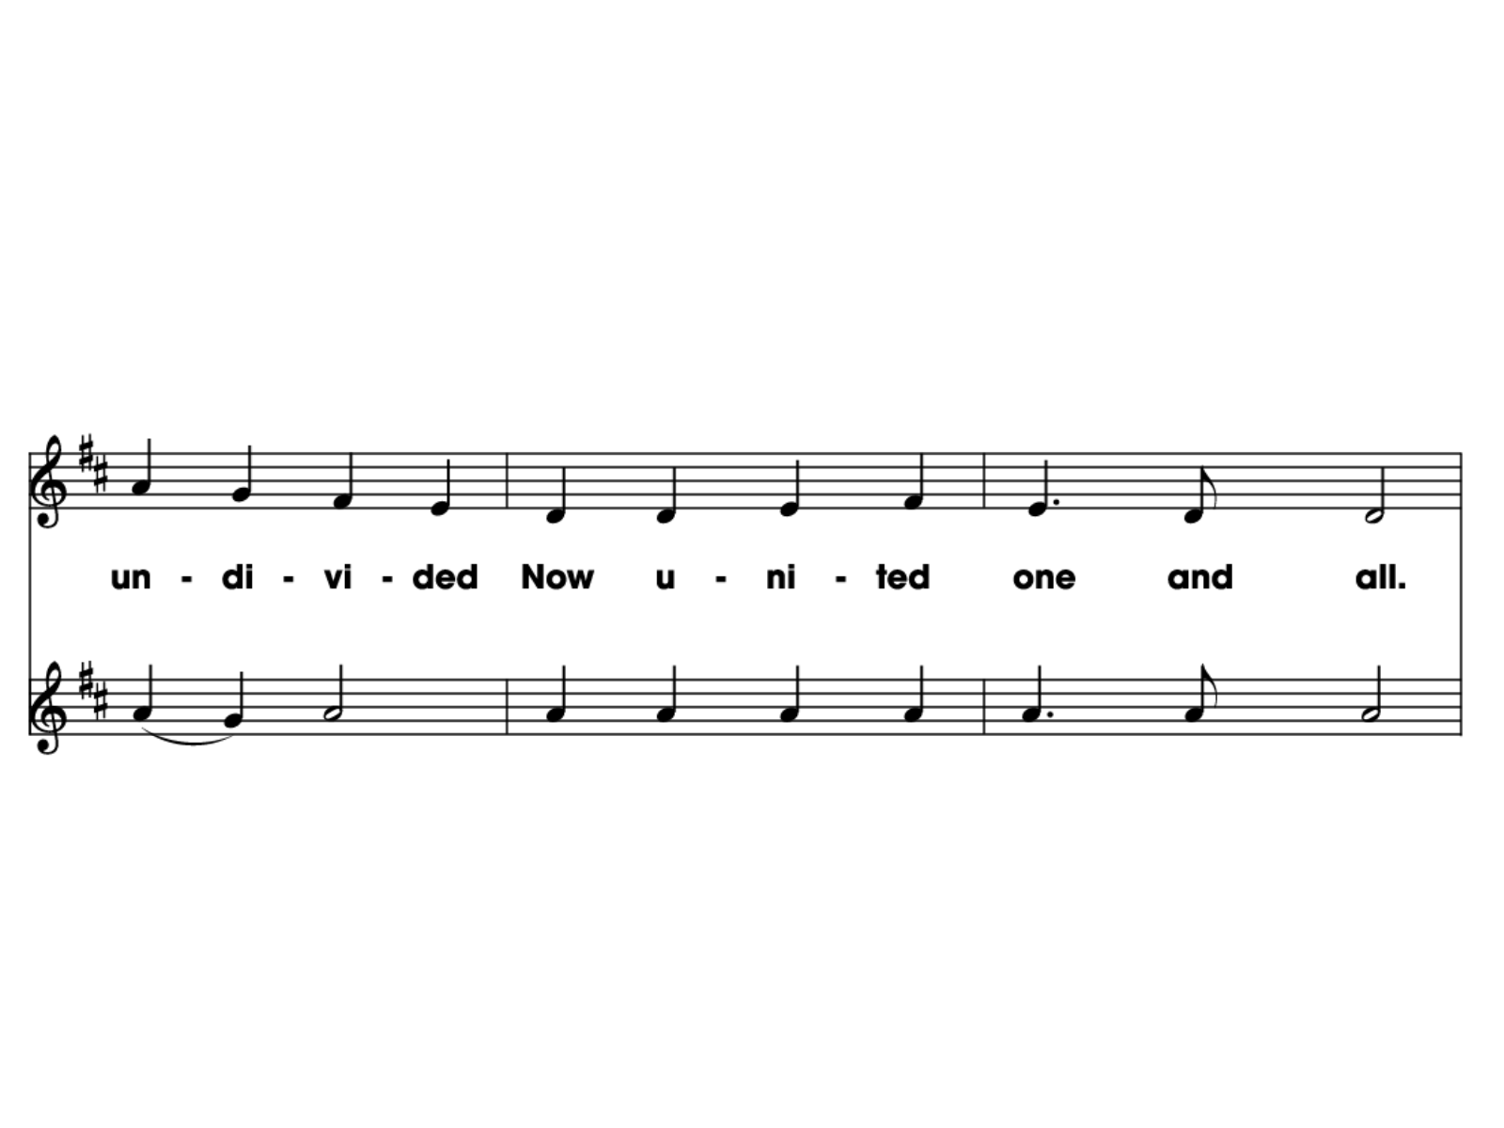
SING!
PLAY!
Click for Table of Contents
Notes:
ODE MUSIC 5

Slide 64


Click for Table of Contents
Notes:
TOREADOR TITLE

Slide 65
Toreador chorus is sung by students
Carnegie Hall Resources: https://www.carnegiehall.org/Education/Programs/Link-Up/National-Program/The-Orchestra-Moves/Toreador
Quaver Active Listening: https://users.quavered.com/QR/DDUFMK
Click for Table of Contents
Notes:
TOREADOR TITLE

Slide 66


Click for Table of Contents
Notes:
TOREADOR EMOTIONS

Slide 67
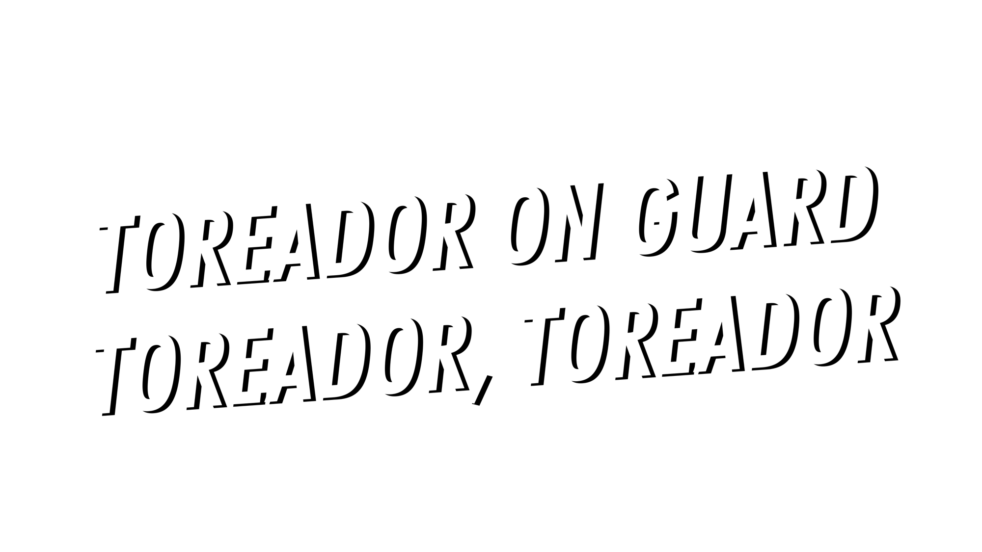
Click for Table of Contents
Notes:
TOREADOR LYRICS 1

Slide 68

Click for Table of Contents
Notes:
TOREADOR LYRICS 2

Slide 69

Click for Table of Contents
Notes:
TOREADOR LYRICS 3

Slide 70

Click for Table of Contents
Notes:
TOREADOR LYRICS 4

Slide 71

Click for Table of Contents
Notes:
TOREADOR LYRICS 5

Slide 72
Click for Table of Contents
Notes:
TOREADOR LYRICS 6

Slide 73
Click for Table of Contents
Notes:
TOREADOR LYRICS 7

Slide 74
Click for Table of Contents
Notes:
TOREADOR LYRICS 8

Slide 75
Click for Table of Contents
Notes:
TOREADOR LYRICS 9

Slide 76
Click for Table of Contents
Notes:
TOREADOR LYRICS 10

Slide 77
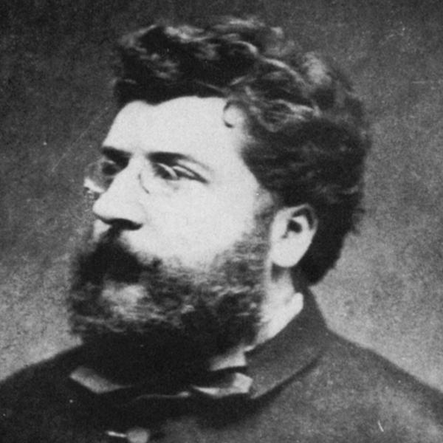
About the Composer
George Bizet: Georges Bizet (1838–1875) was a French composer with a musical family. His mother, a pianist, and his father, a composer and voice teacher, recognized Bizet’s talent early. When he was nine, his father enrolled him in the Paris Conservatory of Music, where he was known as a masterful pianist and an award-winning composer. He wrote more than 150 compositions for the piano, as well as a symphony, orchestral suites, operas, and songs. His final masterpiece, Carmen, an opera that caused an uproar at its 1875 premiere, is now celebrated and performed all over the world.
Click for Table of Contents
Notes:
ODE TITLE

Slide 78

Click for Table of Contents
Notes:
OYE TITLE

Slide 79




OYE Cover
Link to Singing: https://www.carnegiehall.org/Education/Programs/Link-Up/National-Program/The-Orchestra-Sings/Oye#bio
Scroll down on the link above to hear the pronunciation guide. Translation is also available on this page.
Link to Dance Tutorial:
https://vimeo.com/221942907
Click for Table of Contents

Slide 80

OYE Chorus
Click for Table of Contents
Notes:
OYE MUSIC 1

Slide 81

OYE Chorus
Click for Table of Contents
Notes:
OYE MUSIC 2

Slide 82


Click for Table of Contents
Notes:
OYE MUSIC 3

Slide 83

OYE Cover
Click for Table of Contents
Notes:
OYE MUSIC 5

Slide 84
OYE Cover
Click for Table of Contents
Notes:
OYE MUSIC 3

Slide 85

OYE Cover
Click for Table of Contents
Notes:
OYE MUSIC 8

Slide 86
OYE Cover
*Dance Mode*
Click for Table of Contents
Notes:
OYE MUSIC 9

Slide 87

OYE Chorus
Click for Table of Contents
Notes:
OYE MUSIC 10

Slide 88
OYE Chorus
Click for Table of Contents
Notes:
OYE MUSIC 11

Slide 89
OYE Cover
Click for Table of Contents
Notes:
OYE MUSIC 3

Slide 90
OYE Cover
Click for Table of Contents
Notes:
OYE MUSIC 14

Slide 91
OYE Cover
Click for Table of Contents
Notes:
OYE MUSIC 3

Slide 92
OYE Cover
Notes:
OYE MUSIC 17

Slide 93
OYE Cover
*Dance Mode*
Click for Table of Contents
Notes:
OYE MUSIC 9

Slide 94




OYE Cover
Click for Table of Contents
Notes:
OYE MUSIC 18

Slide 95

OYE Cover
Click for Table of Contents
Notes:
OYE MUSIC 23

Slide 96
Click for Table of Contents

Slide 97
Click for Table of Contents

Slide 98
OYE Cover
Click for Table of Contents
Notes:
OYE MUSIC 34

Slide 99
Click for Table of Contents

Slide 100
Click for Table of Contents

Slide 101
Click for Table of Contents

Slide 102
OYE Cover
Click for Table of Contents
Notes:
OYE MUSIC 37

Slide 103
OYE Cover
Click for Table of Contents
Notes:
OYE MUSIC 3

Slide 104
OYE Cover
Click for Table of Contents
Notes:
OYE MUSIC 34

Slide 105
OYE Cover
Click for Table of Contents
Notes:
OYE MUSIC 3

Slide 106
OYE Cover
Click for Table of Contents
Notes:
OYE MUSIC 37

Slide 107

OYE Chorus
Click for Table of Contents
Notes:
OYE MUSIC 38

Slide 108
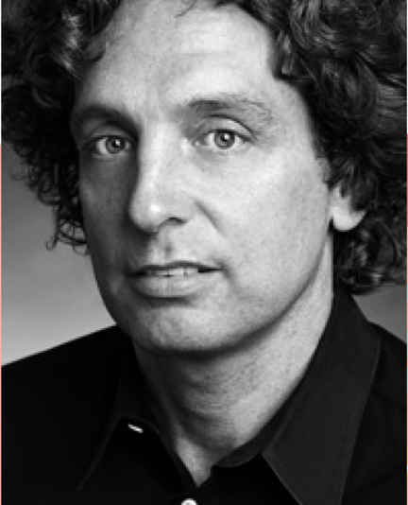
About the Composer
Jim Papoulis (b. 1961) lives in New Yourk City and composes, orchestrates, and conducts music for dance, film, ensembles, and choirs. His compostiions are known for exploring new modes of musical communication by honoring and connecting classical and traditional forms with non-Western sounds. Through the Foundation for Small voices, he has conducted songwriting workshops around the qworld; he composed “oye” while working with young children in Mexico. Papoulis has worked with a wide range of artists, including Shania Twain, Celine Dion, Aretha Franklin, the New York Philharmonic, the Chicago Symphony Orchestra, London Boys Choir, Beijing Children’s Choir, Failth Hill, Natalie Cole, Snoop Dogg, Slash, and Beyoncé.
*** SOMEWHERE KAYLIN LEARNED THAT HE WROTE THIS SONG FOR THE KIDS TO SHARE A MESSAGE. THEY WANTED ADULTS TO KNOW THAT THEY HAD SOMETHING TO SAY, AND IT IS MEANINGFUL OR SOMETHING….
Click for Table of Contents

Slide 109
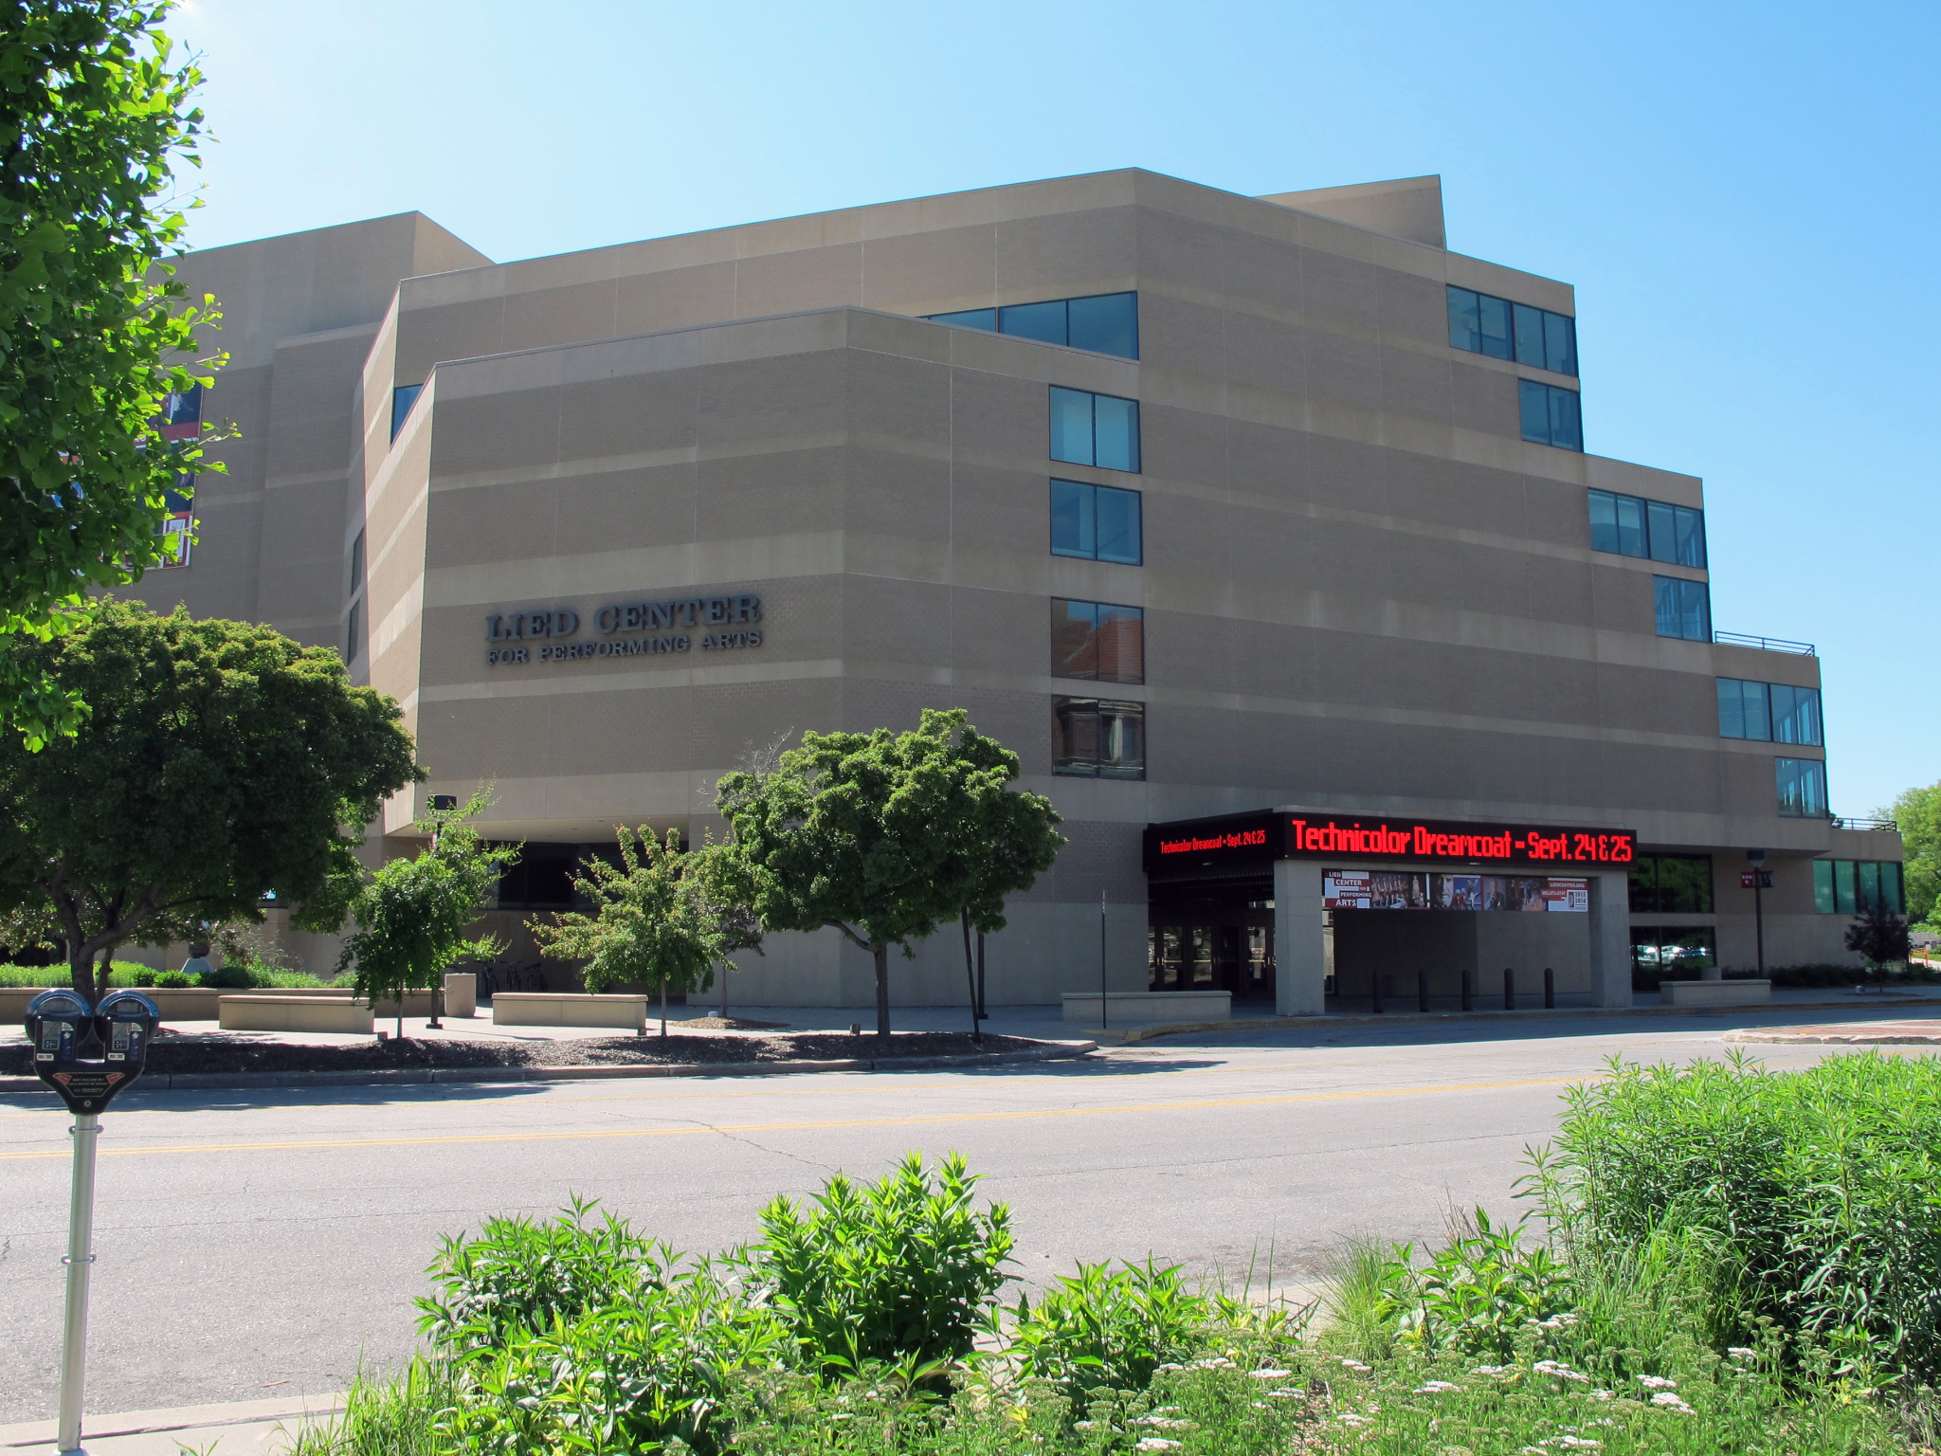
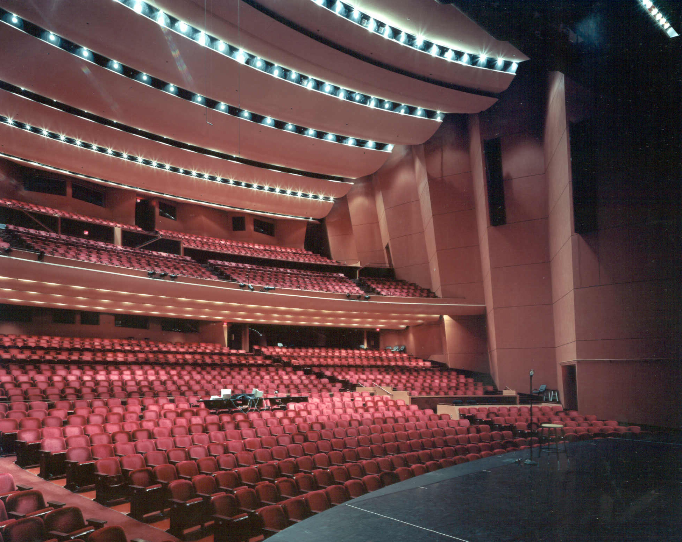
End: See you at the concert!
Click for Table of Contents

Slide 110
Links to Lyric Cheat Sheets and Letter to Teachers:
Lyric Cheat Sheet Link: Lyric Sheet
Letter to chaperones and classroom teachers with concert and field trip expectations: Letter for Teachers
Click for Table of Contents

Slide 111
OPTIONAL ACTIVITIES TO USE AT TEACHER’S DISCRETION
These videos and activities are supplemental and are optional. They are not pertinent to the success of the students during the Young People’s Concert. Please feel free to use at your own discretion.
Click for Table of Contents

Slide 112

FOR CONCERT ETIQUETTE
Click for Table of Contents

Slide 113
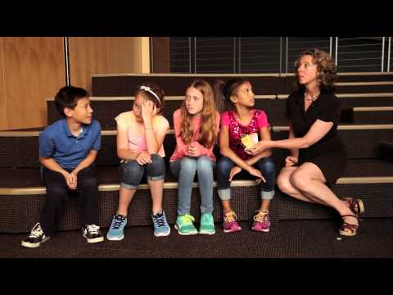
What To Do at a Concert
Click for Table of Contents
Notes:
Click on image to play video

Slide 114
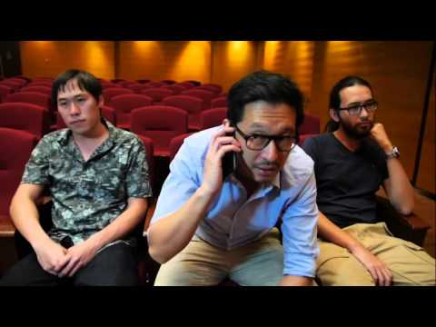
Concert Etiquette Video
Click for Table of Contents
Notes:
Click on image to play video

Slide 115
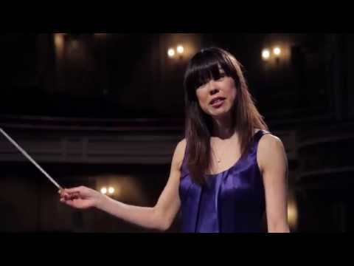
What does a conductor do?
Click for Table of Contents
Notes:
Click on image to play video

Slide 116
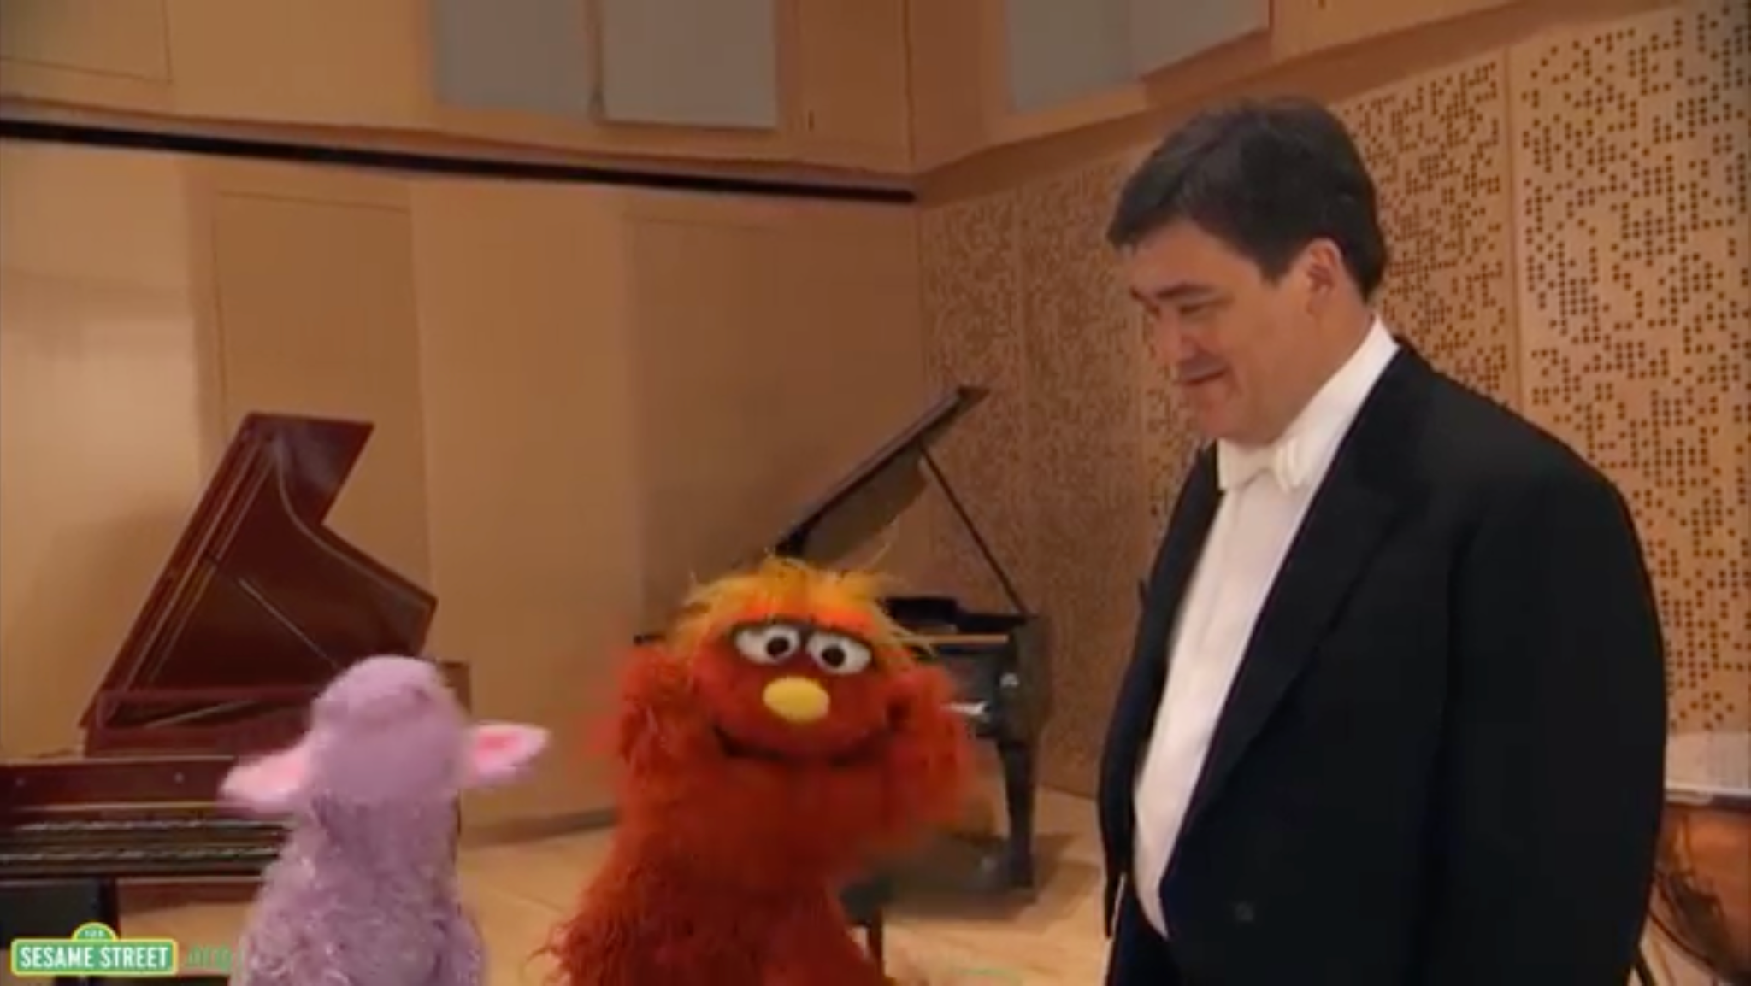
Sesame Street: Conductor
Click for Table of Contents
Notes:
Click on image for the link

Slide 117
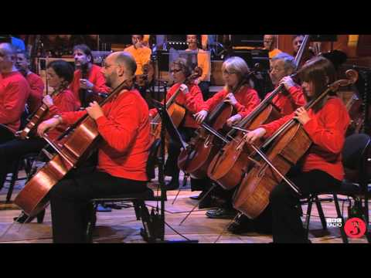
Meet the Orchestra
Click for Table of Contents
Notes:
Click on image to play video

Slide 118
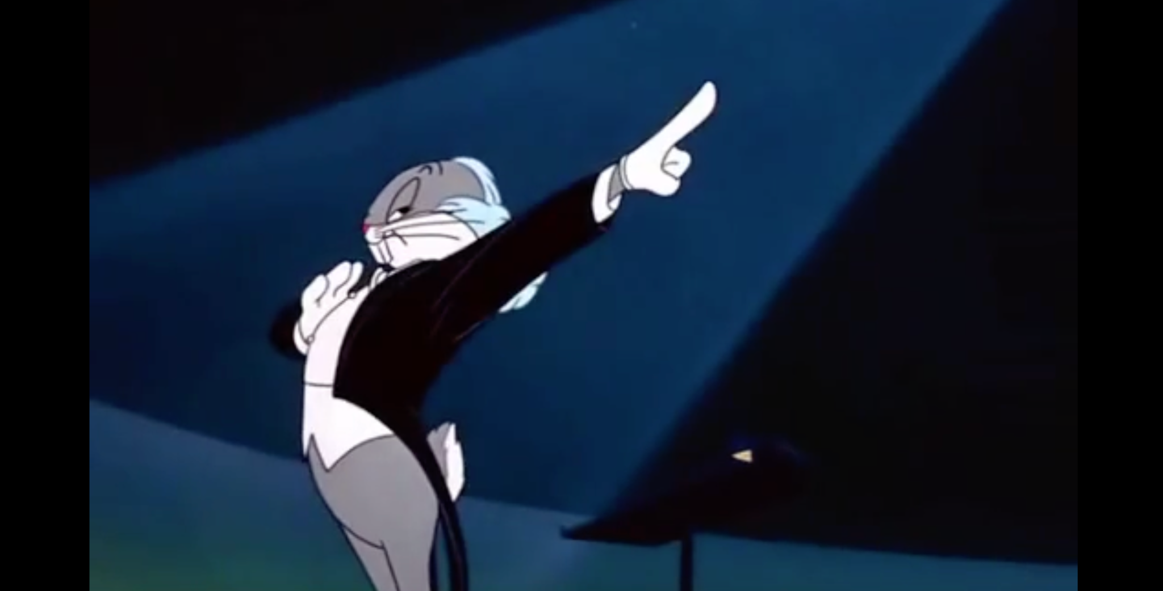
Bugs Bunny Conducting
Click for Table of Contents
Notes:
Click on image for the link

Slide 119
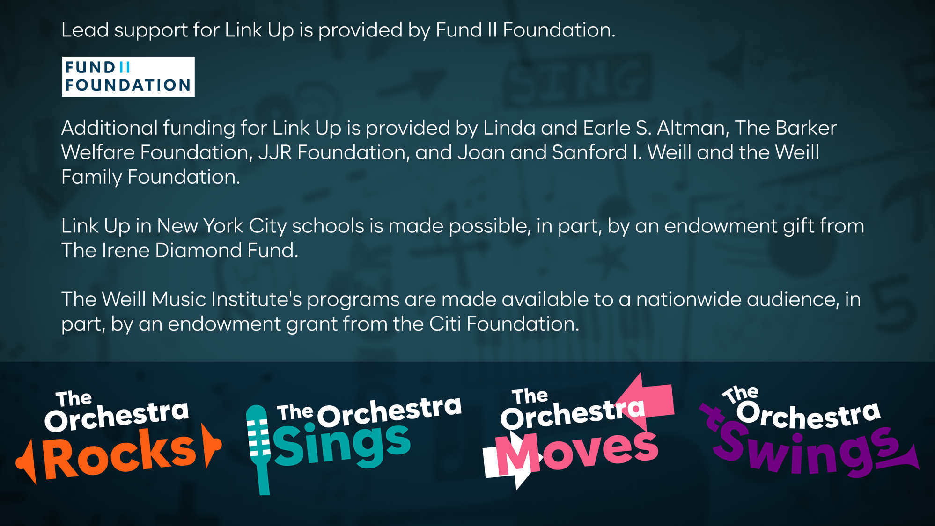
Notes:
CREDITS

